Slide 1

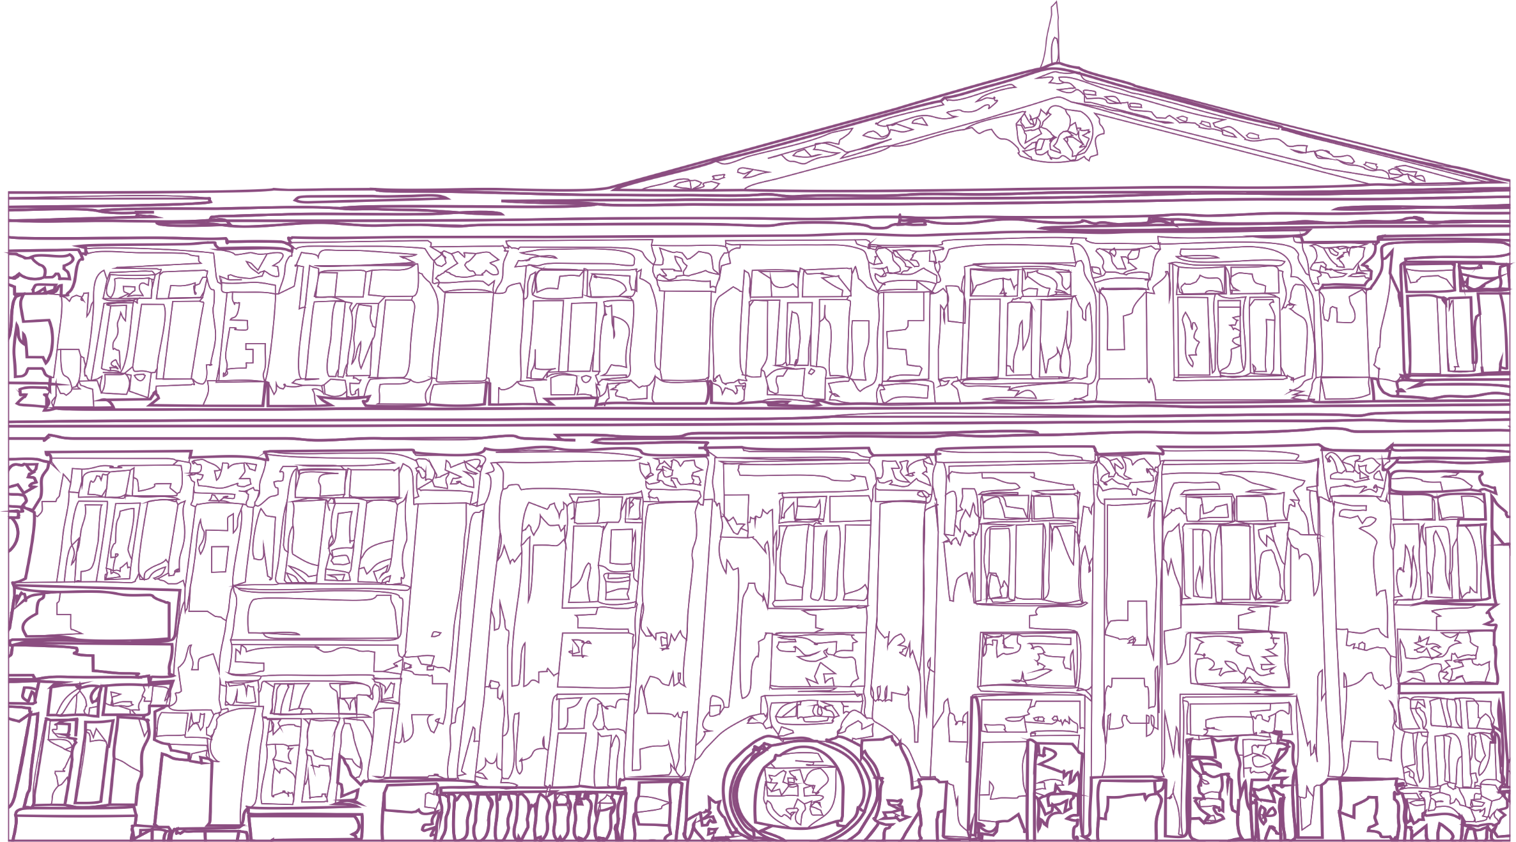

ASFENDIYAROV KAZAKH NATIONAL MEDICAL UNIVERSITY
Font – Times New Roman 16 пт
Title (1-2 lines)
Font – Times New Roman 32 пт
Presentation title
Full name of the speaker
Subtitle
Font - Times New Roman 24 пт
Almaty - 2023

Slide 2
Heading (1 line) no more than 5-6 words
Font – Times New Roman 24 пт
SLIDE TITLE
Subtitle
Font – Times New Roman 20 пт
Subtitle
Body text
Font – Calibri bold 16-18 пт
Text
Subtitle
Font – Times New Roman10,5 пт
ASFENDIYAROV UNIVERSITY

Slide 3
Heading (1 line) no more than 5-6 words
Font – Times New Roman 24 пт
SLIDE TITLE
Subtitle
Font – Times New Roman 20 пт
Subtitle
Body text
Font – Calibri bold 16-18 пт
Text
Subtitle
Font – Times New Roman10,5 пт
ASFENDIYAROV UNIVERSITY

Slide 4
Heading (1 line) no more than 5-6 words
Font – Times New Roman 24 пт
SLIDE TITLE
Subtitle
Font – Times New Roman 20 пт
Subtitle
Body text
Font – Calibri bold 16-18 пт
Text
Subtitle
Font – Times New Roman10,5 пт
ASFENDIYAROV UNIVERSITY

Slide 5

Heading
Font – Times New Roman 14 пт
ASFENDIYAROV KAZAKH NATIONAL MEDICAL UNIVERSITY
Heading
Font – Times New Roman 32 пт
Thank you for your attention!
​Almaty, Tole bi str., 94
+7 727 338 70 90
kaznmu.kz
kaznmu@kaznmu.kz
​@kaznmu
https://www.facebook.com/KazNMU
https://www.youtube.com/kaznmu

